Slide 1
Unit V MATHEMATICAL AND VISUAL ANALYTICS IN TABLEAU

Slide 2
Table of content
Calculations: Aggregate, Date, Logic, Number, String, Type.
Conceptual Topics with LOD Expressions
Nested LOD Expressions Showing change instead of raw numbers
Summary statistics in visualizations
Annotations and pre-attentive attributes
Use visual analytics to find answers in your data
Adding annotations to visualization
Add reference lines and trend lines
Visualizing forecasting data
Clustering
Drag and drop analytics,
Analysis with cube and MDX

Slide 3
1.1 Aggregate Calculations
Aggregate functions allow you to summarize or change the granularity of your data.
The most commonly used functions in tableau are listed below:
SUM: sum of values
AVG: average of values
MIN: minimum of values
MAX: maximum of values
VAR: variance of sample population
VARP: variance of entire population
STDEV: standard deviation of sample population
STDEVP: standard deviation of entire population
COUNT: count of values.

Slide 4
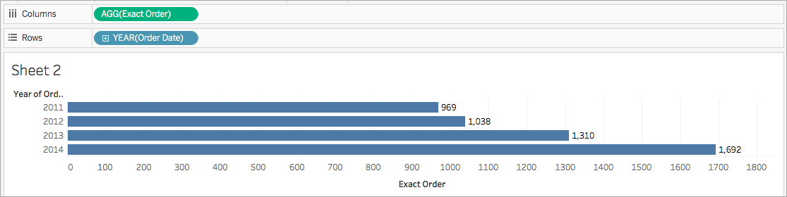
Aggregate function
https://help.tableau.com/current/pro/desktop/en-us/calculations_calculatedfields_aggregate_create.htm

Slide 5
1.2 Date Calculations
DATEADD :
Add 280 days to the date February 20, 2021
DATEADD('day', 280, #2/20/21#)
= #November 27, 2021#
DATEDIFF
Number of days between March 25, 1986 and February 20, 2021
DATEDIFF('day', #3/25/1986#, #2/20/2021#)
= 12,751
DATENAME
Returns the name of the specified date part as a discrete string.
DATENAME('year', #3/25/1986#) = "1986"

Slide 6
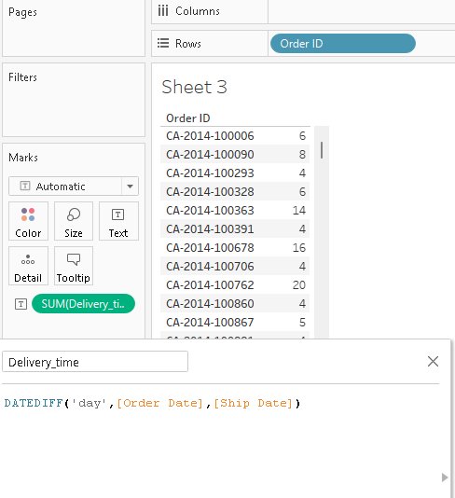
Example: date function

Slide 7
https://help.tableau.com/current/pro/desktop/en-us/functions_functions_date.htm

Slide 8
1.3 Logic Calculations
Logical calculations allow you to determine if a certain condition is true or false (Boolean logic). Eg:
IF [Profit] > 0 THEN 'Profitable' ELSEIF [Profit] = 0 THEN 'Break even' ELSE 'Loss' END

Slide 9
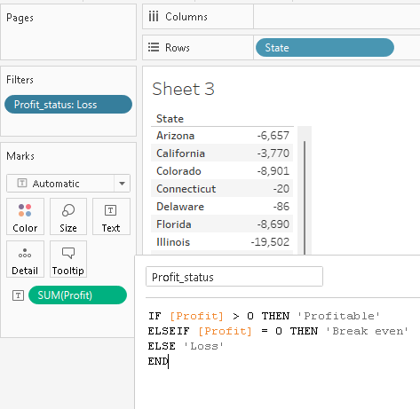
Example: logical calculation

Slide 10
Case syntax
IF [Season] = "Spring" AND "[Season] = "Fall" THEN "It's the apocalypse and footwear doesn't matter" END
CASE [Season] WHEN 'Summer' THEN 'Sandals' WHEN 'Winter' THEN 'Boots' ELSE 'Sneakers' END

Slide 11
IF [Season] = "Summer" THEN 'Sandals' ELSEIF [Season] = "Winter" THEN 'Boots' ELSEIF [Season] = "Spring" THEN 'Sneakers' ELSEIF [Season] = "Autumn" THEN 'Sneakers' ELSE 'Bare feet' END
https://help.tableau.com/current/pro/desktop/en-us/functions_functions_logical.htm

Slide 12
Create a logical calculation
Connect to the Sample - Superstore & Navigate to a worksheet.
From the Data pane, drag State & drag Category to the Rows shelf & drag Sales to the Columns shelf.
Select Analysis > Create Calculated Field.
In the calculation editor that opens, do the following:
Name the calculated field KPI.
Enter the following formula: SUM([Profit]) > 0
This calculation returns true/ false.
When finished, click OK.
The new calculated field appears under Measures in the Data pane
From the Data pane, drag KPI to Color on the Marks card. You can now see which categories are losing money in each state.

Slide 13
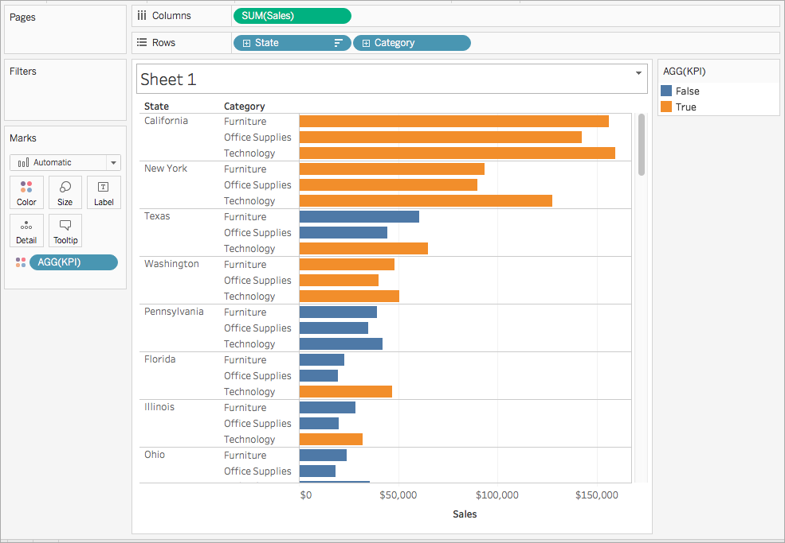
https://help.tableau.com/current/pro/desktop/en-us/functions_functions_logical.htm

Slide 14
1.4 Number Calculations
Number functions allow you to perform computations on the data values in your fields. Number functions can only be used with fields that contain numerical values.
ABS(-7) = 7
CEILING(2.1) = 3
DIV(integer1, integer2)
FLOOR(7.9) = 7
https://help.tableau.com/current/pro/desktop/en-us/functions_functions_number.htm

Slide 15
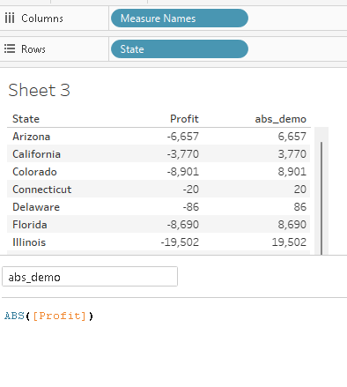
abs function

Slide 16
1.5 String Calculations
String functions allow you to manipulate string data.
SPLIT('Jane Johnson' , ' ', 2) = 'Johnson’
ASCII('A') = 65
CHAR(65) = 'A‘
CONTAINS("Calculation", "alcu") = true
LEN("Matador") = 7
LOWER("ProductVersion") = "productversion“
LTRIM(" Matador ") = "Matador "
https://help.tableau.com/current/pro/desktop/en-us/functions_functions_string.htm

Slide 17
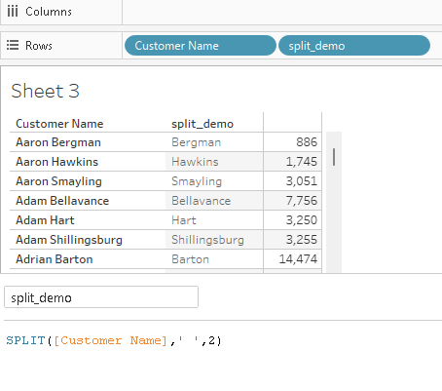

Slide 18
1.6 Type Calculations
The main types of calculations available to you in Tableau are:
Basic expressions:
Row-level calculations
Aggregate calculations
Table calculations
Level of Detail (LOD) expressions:
FIXED LOD
INCLUDE LOD
EXCLUDE LOD
https://www.salesforceben.com/overview-of-tableau-calculated-fields/

Slide 19
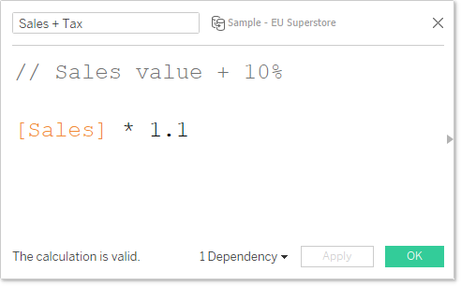
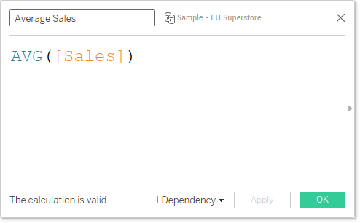
Basic expressions
Row-level calculations
Aggregate calculations

Slide 20
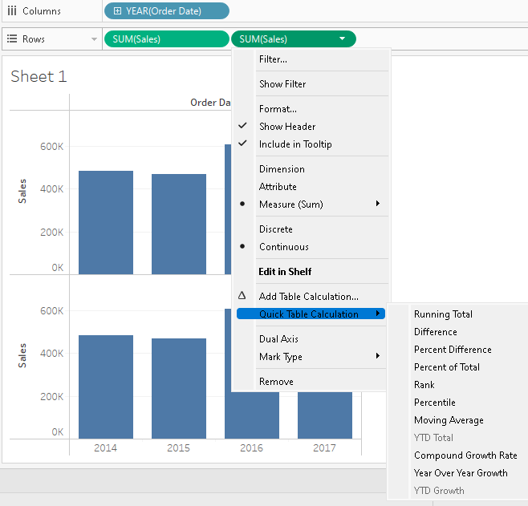
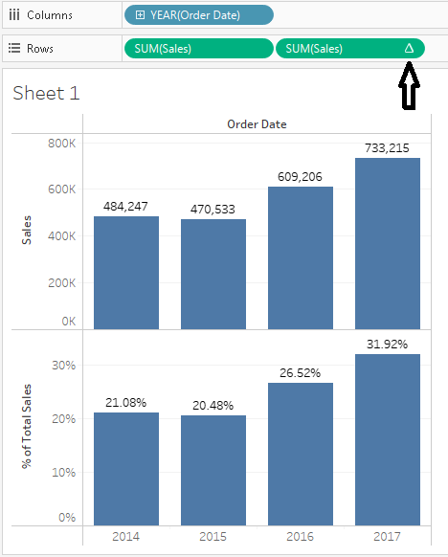
Table calculation

Slide 21
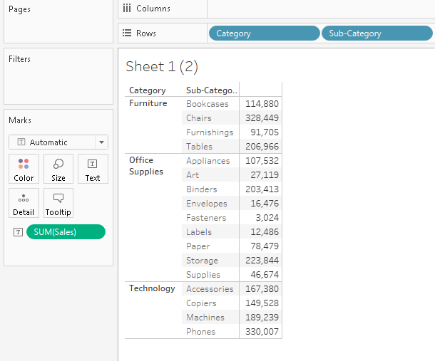
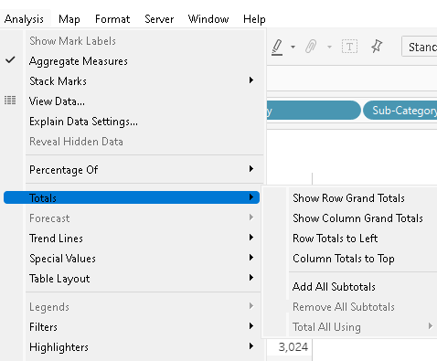

Slide 22
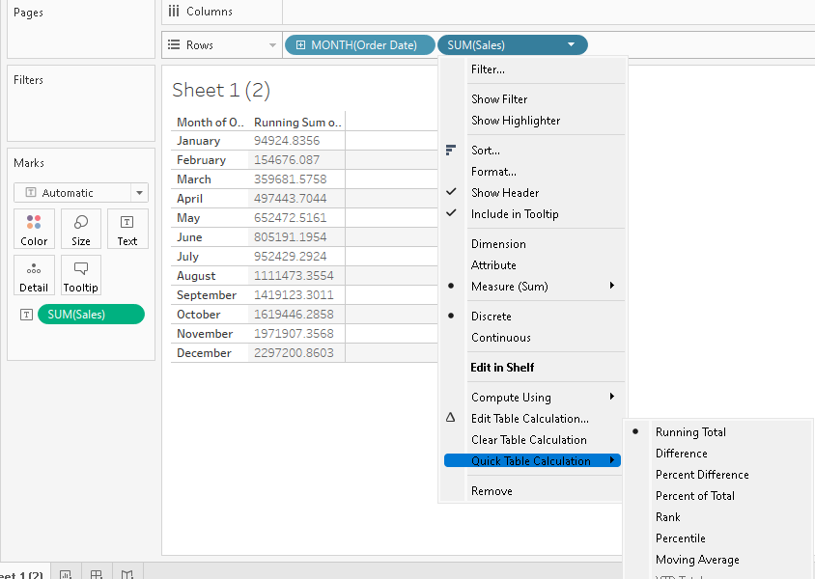

Slide 23
2. Conceptual Topics with LOD Expressions
Level of Detail (LOD) expressions are used to run complex queries involving many dimensions at the data source level instead of bringing all the data to Tableau interface. Type are:
FIXED LOD: computes values using the specified dimensions without reference to any other dimensions in the view.
INCLUDE LOD: compute values using the specified dimensions in addition to whatever dimensions are in the view.
EXCLUDE LOD: subtract dimensions from the view level of detail.
https://www.tutorialspoint.com/tableau/tableau_lod_expressions.htm
Notes:
https://www.youtube.com/watch?v=udHOJ2hMS0E

Slide 24
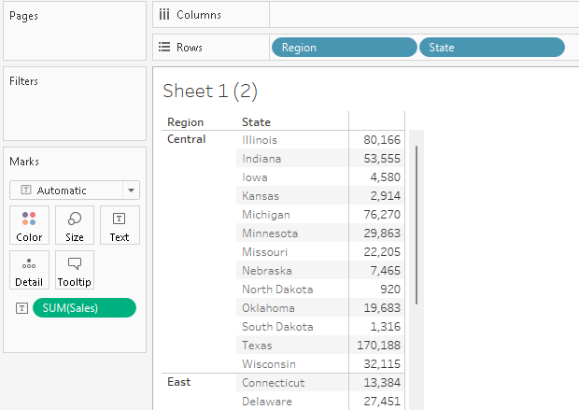
FIXED Level of Detail Expressions
Sometimes you want to get an overall aggregate so you can do some comparisons.

Slide 25
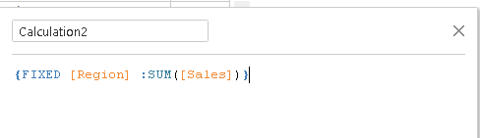
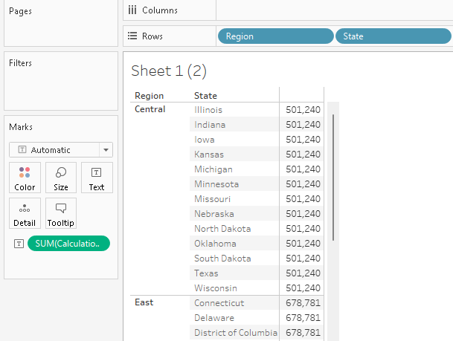
Drag the Region field to the Color shelf instead sum(sales).
Shows a fixed value for different states. That is because we have fixed the dimension as region for the calculation of Sales value.

Slide 26
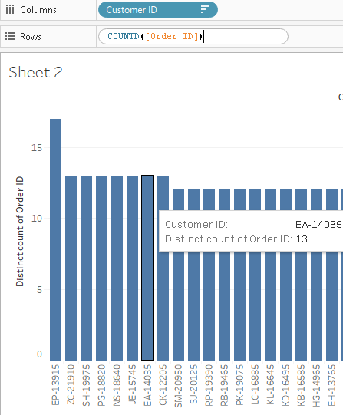
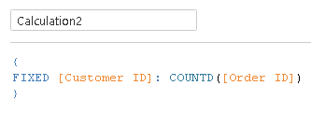
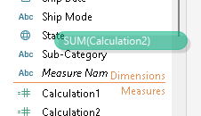
Example 2
Create calculated field
Convert it into dimension
Popular order: How many customers order how many items.
No. of order per customer

Slide 27
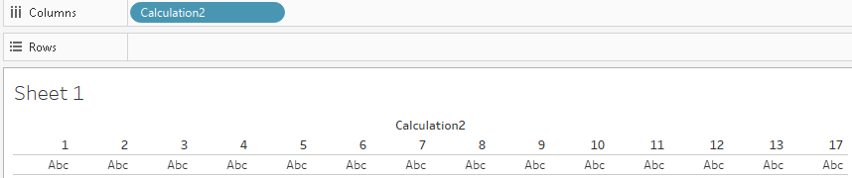
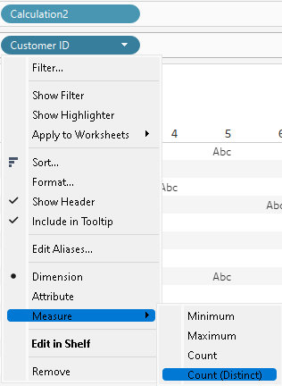
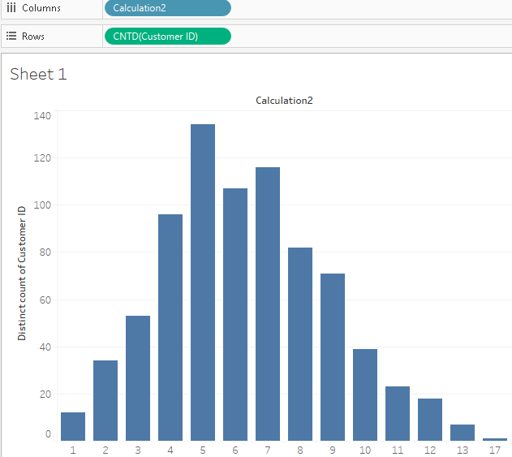

Slide 28
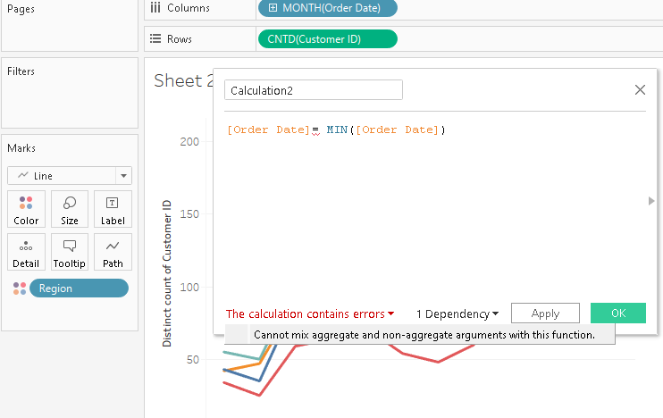
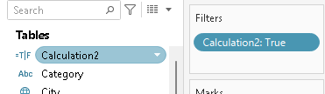
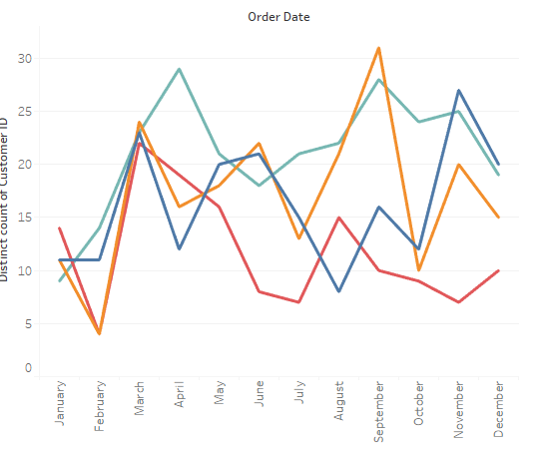
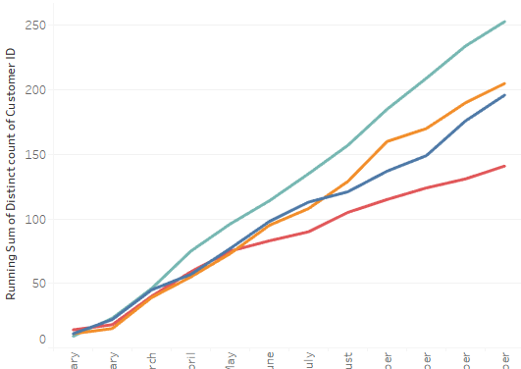

To do
Customer who placed first order
Change Customer ID to running total from countD

Slide 29
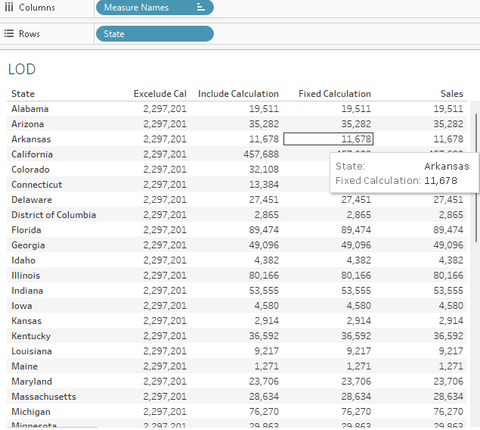
INCLUDE Level of Detail Expressions
Exclude state (level)
-> Total sales
Calculated Field: { Exclude | Include| Fixed [State] : sum[Sales] }

Slide 30
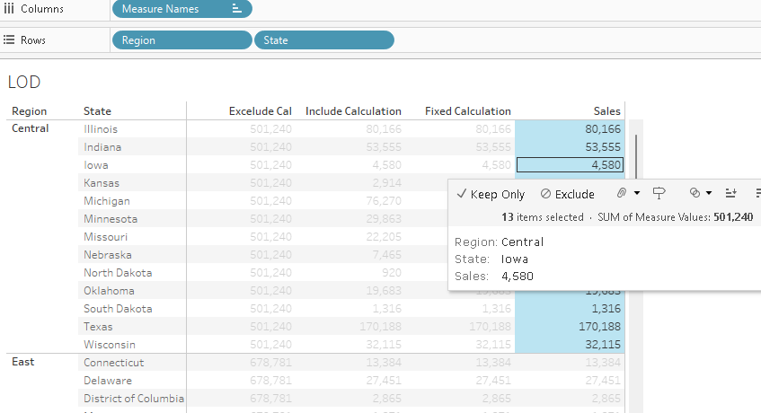
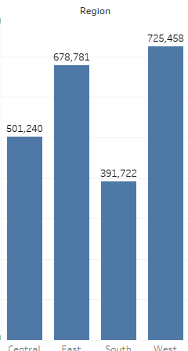
When Segment is introduced, Fixes : state-wise, Exclude: now Region-wise

Slide 31
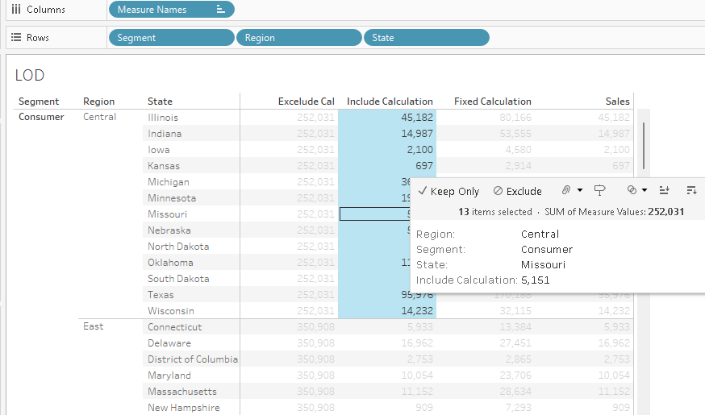
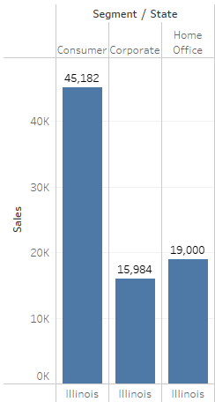

Slide 32
3. Nested LOD Expressions Showing change instead of raw numbers
The nested LOD will always get the overall average (because it's not fixed on any dimensions).
It doesn't care about the viz level of detail.
The non-nested calculation is just a normal aggregation, so it will care about the level of detail.
Nested:
{ FIXED :AVG({FIXED [Customer ID]:COUNTD([Order ID])})}
Simple :
AVG({FIXED [Customer ID]:COUNTD([Order ID])})

Slide 33
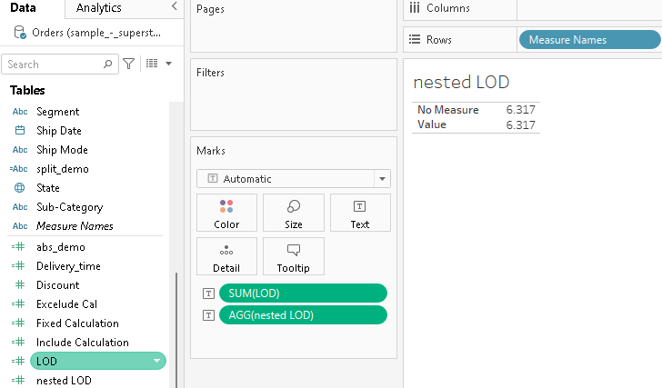
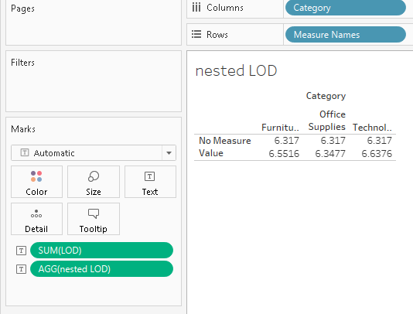

Slide 34
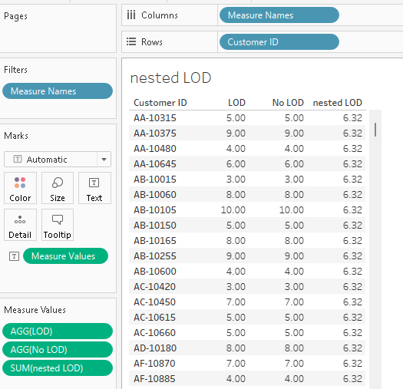

Slide 35
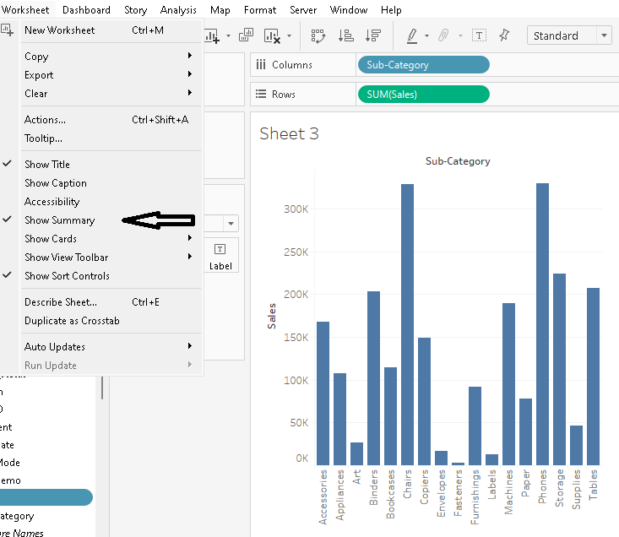
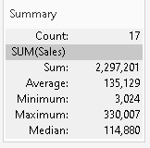
4. Summary statistics in visualizations

Slide 36
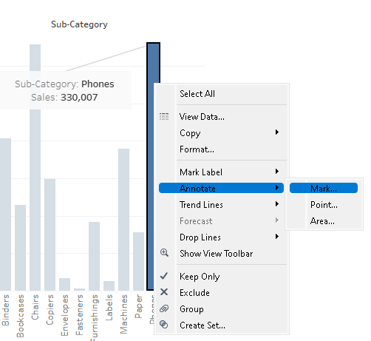
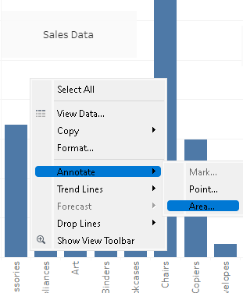
5.1 Annotations
Annotations

Slide 37
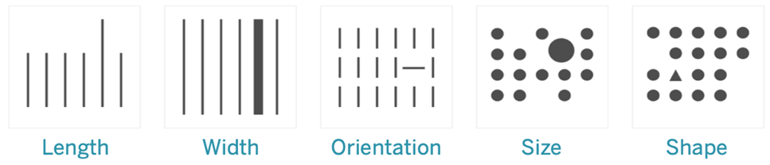
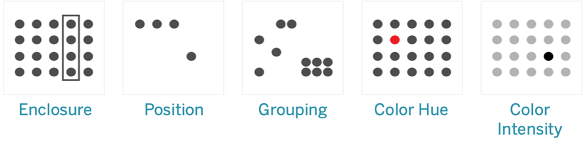
5.2 Pre-attentive attributes
Visual analytics is a means of exploring and understanding data. It supports and accelerates the analysis process itself.
These are generally the best ways to present data, because we can see these patterns without thinking or processing.
In fact, these attributes evolved in humans as ways to quickly assess a situation
Notes:
https://help.tableau.com/current/blueprint/en-us/bp_why_visual_analytics.htm

Slide 38
6. Use visual analytics to find answers in your data
Visual analytics is a means of exploring and understanding data.
It supports and accelerates the analysis process itself. You can ask a question, get the answer, and ask follow-up questions—all within a visual interface.
A story unfolds from one visual summary to another.
In short, visual analytics allows you to go in any direction with your thoughts while you view and interact directly with the data.

Slide 39
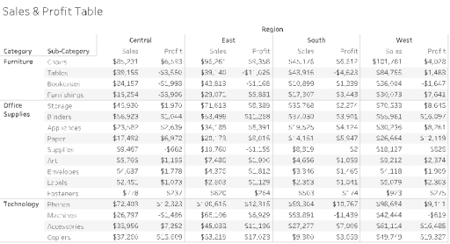
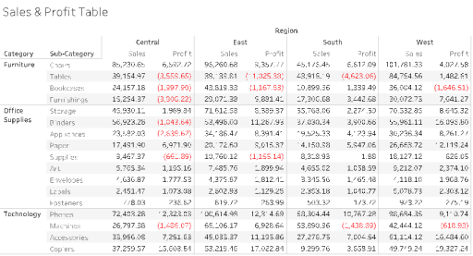
Tabular Data, Plain
Tabular Data with a Color for Negative Values

Slide 40
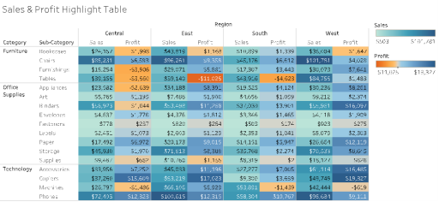
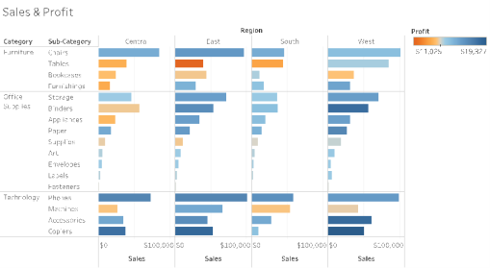
Tabular Data with Sales and Profitability by Color Gradients
Visual Data with Sales by Bar Length, Profitability by Color

Slide 41
7. Adding annotations to visualization
Refer topic 5.1

Slide 42
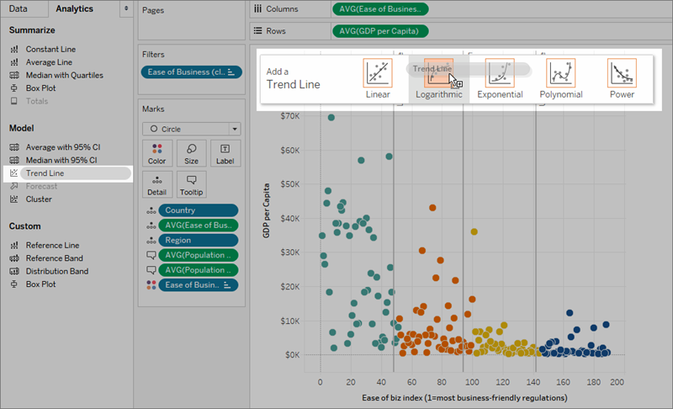
8. Add reference lines and trend lines
https://help.tableau.com/current/pro/desktop/en-us/trendlines_add.htm

Slide 43
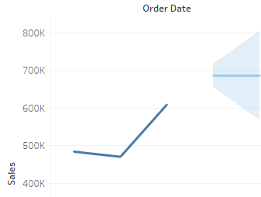
9. Visualizing forecasting data
To visualize forecasting data in Tableau, you can:
Connect to data
Create a visualization
Go to the Analysis tab
Click on Forecast under Model category

Slide 44
10. Clustering
Cluster analysis partitions marks in the view into clusters, where the marks within each cluster are more similar to one another than they are to marks in other clusters.
Drag Cluster from the Analytics pane into the view, and drop it on in the target area in the view:
https://help.tableau.com/current/pro/desktop/en-us/clustering.htm

Slide 45
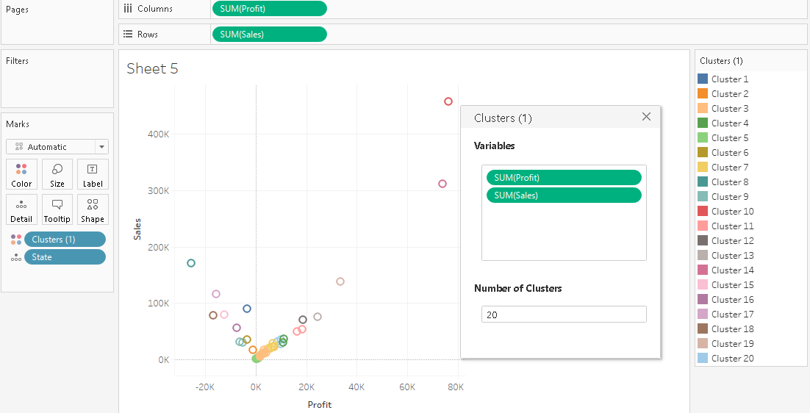

Slide 46
Clustering is available in Tableau Desktop, but is not available for authoring on the web (Tableau Server, Tableau Cloud).
Clustering is also not available when any of the following conditions apply:
When you are using a cube (multidimensional) data source.
When there is a blended dimension in the view.
When there are no fields that can be used as variables (inputs) for clustering in the view.
When there are no dimensions present in an aggregated view.

Slide 47
In addition, the following field types cannot be used as variables (inputs) for clustering:
Table calculations
Blended calculations
Ad-hoc calculations
Generated latitude/longitude values
Groups
Sets
Bins
Parameters
Dates
Measure Names/Measure Values

Slide 48
11. Drag and drop analytics
Tableau's ease of use comes from the fact that it has a drag and drop interface.
This feature helps to perform tasks like sorting, comparing and analyzing, very easily and fast.

Slide 49
12. Analysis with cube and MDX
A cube data source is a data source in which hierarchies and aggregations have been created by the cube's designer in advance.
Cubes are very powerful and can return information very quickly, often much more quickly than a relational data source.
However, the reason for a cube's speed is that all its aggregations and hierarchies are pre-built.
These definitions remain static until the cube is rebuilt.
Thus, cube data sources are not as flexible as relational data sources
https://help.tableau.com/current/pro/desktop/en-us/cubes.htm

Slide 50
The cube data sources supported in Tableau are
Oracle Essbase
Teradata OLAP
Microsoft Analysis Services (MSAS)
SAP NetWeaver Business Warehouse
Microsoft PowerPivot

Slide 51
When working with a cube data source, you can create calculated members using MDX formulas instead of creating Tableau formulas.
MDX, which stands for Multidimensional Expressions, is a query language for OLAP databases.
With MDX calculated members, you can create more complex calculations and reference both measures and dimensions.
A calculated member can be either a calculated measure, which is a new field in the data source just like a calculated field, or a calculated dimension member, which is a new member within an existing hierarchy

Slide 52
https://habr.com/ru/post/658581/

